Slide 1

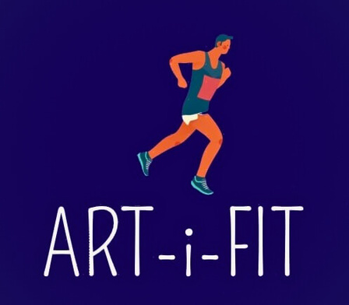
ART-i-FIT

Slide 2
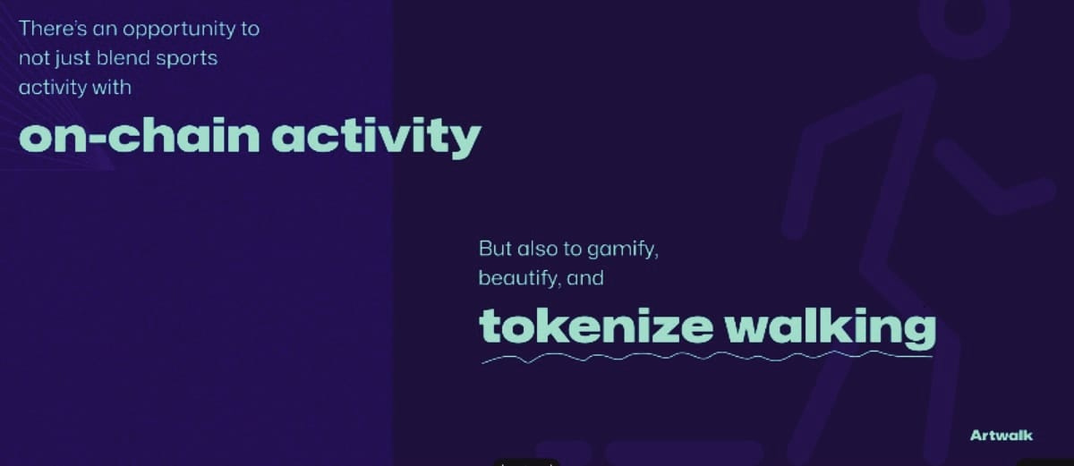

Slide 3
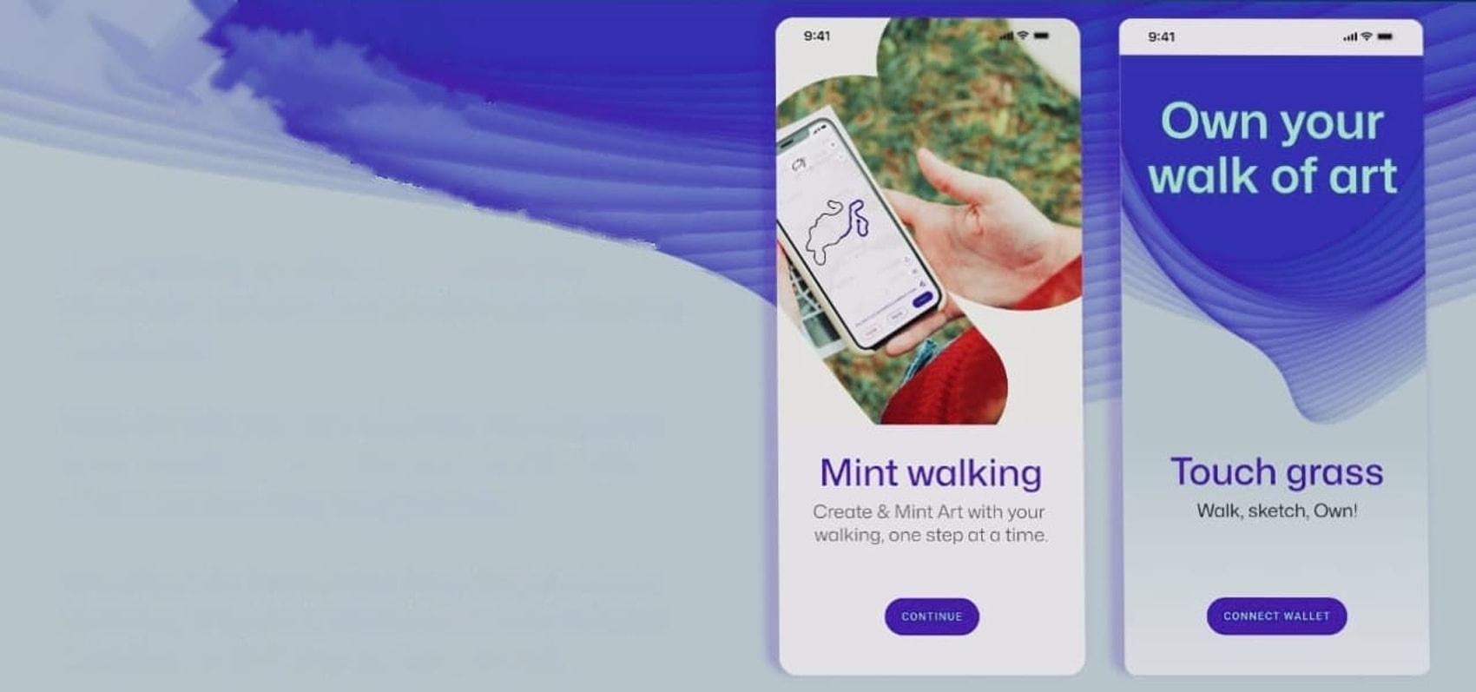
Walk, Create, and Earn: ArtWalk,
Where Art Meets Blockchain...
Bringing the Joy Back to Outdoor Adventures, One Step at a Time
Firstly, Get Started!!

Slide 4
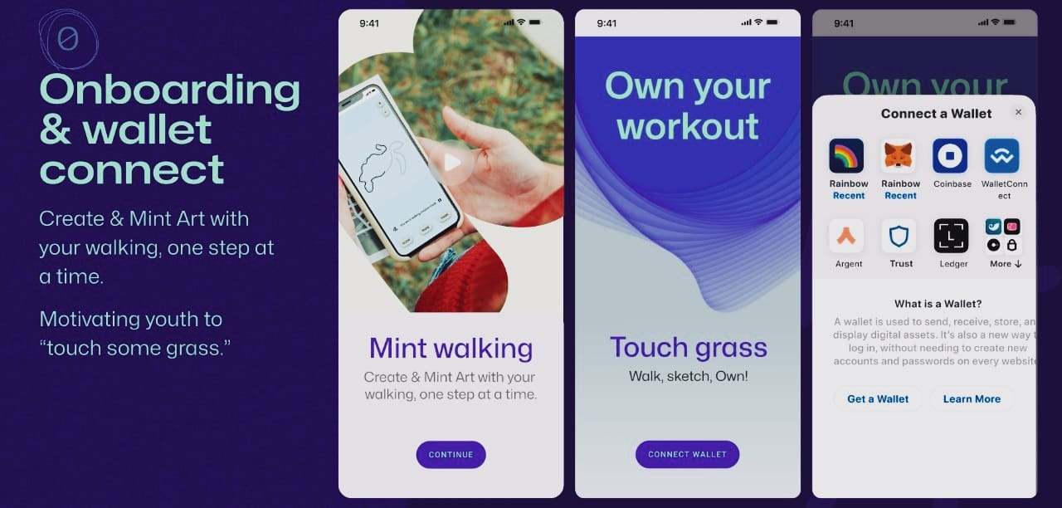

Slide 5
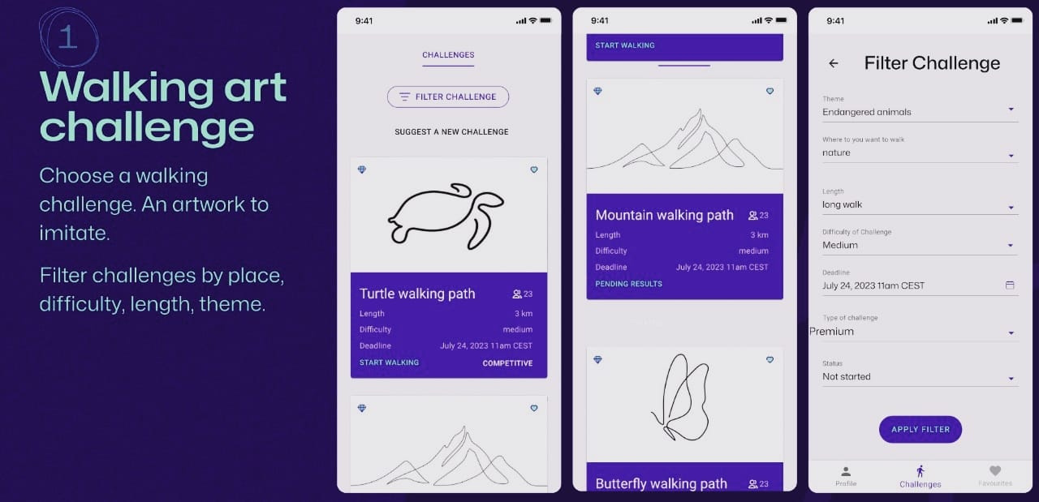

Slide 6
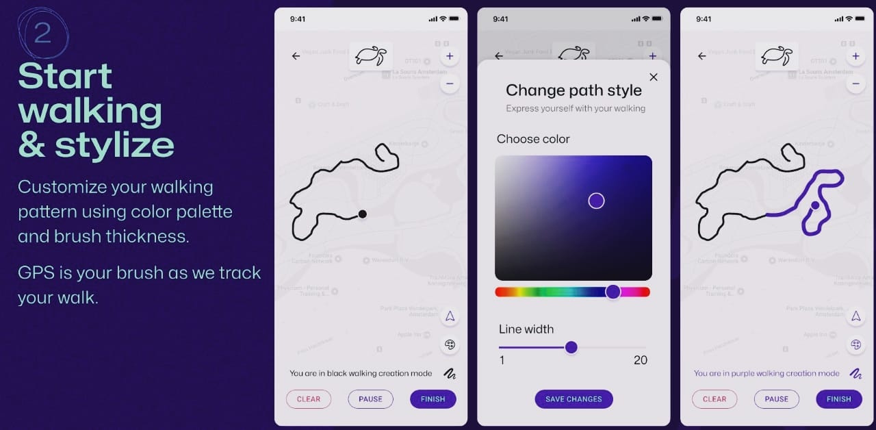

Slide 7
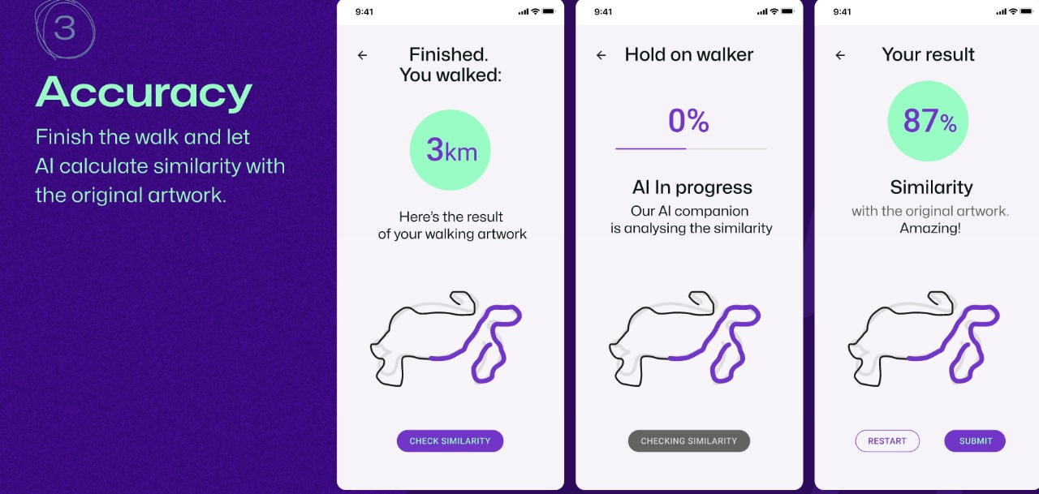

Slide 8
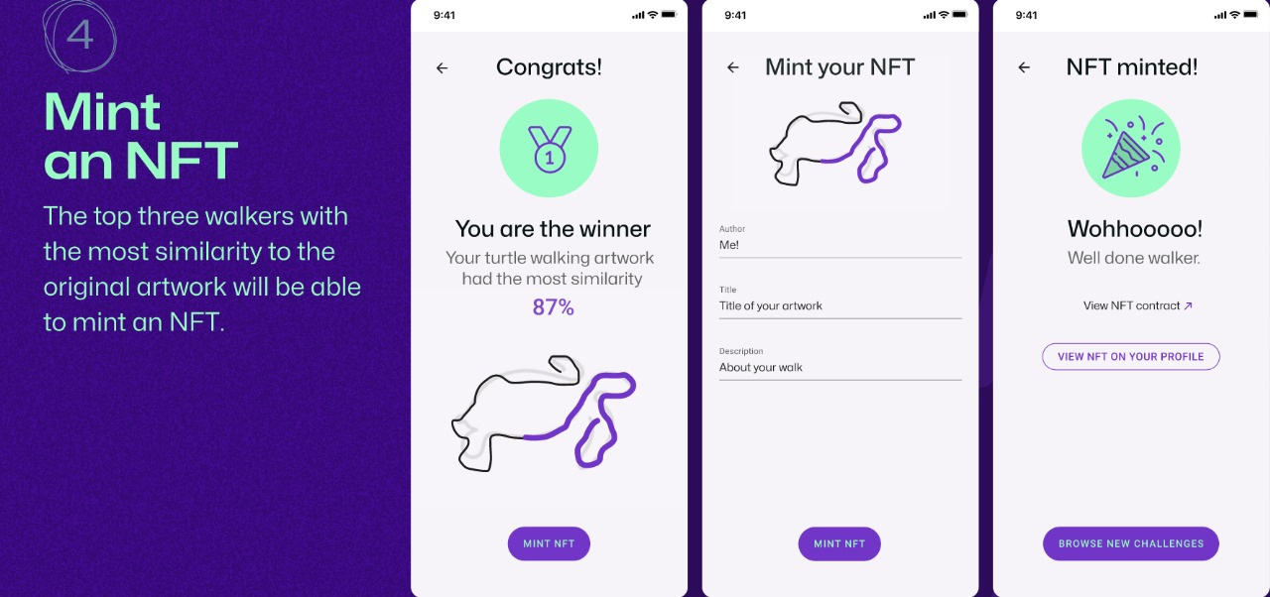

Slide 9
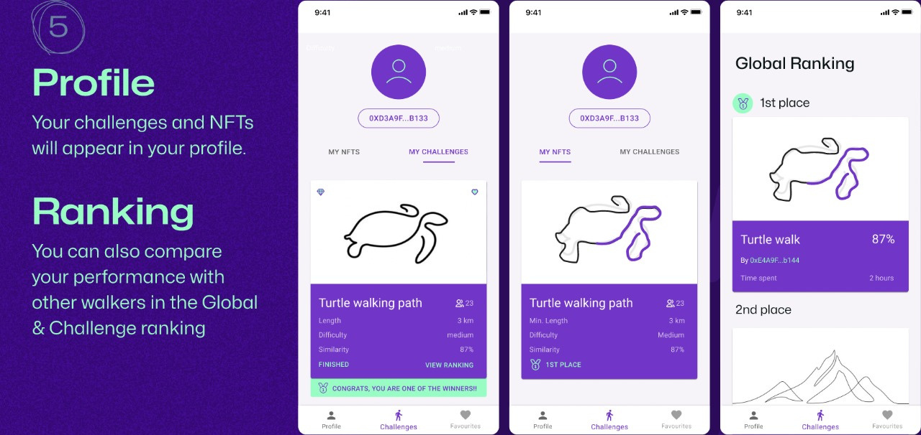

Slide 10
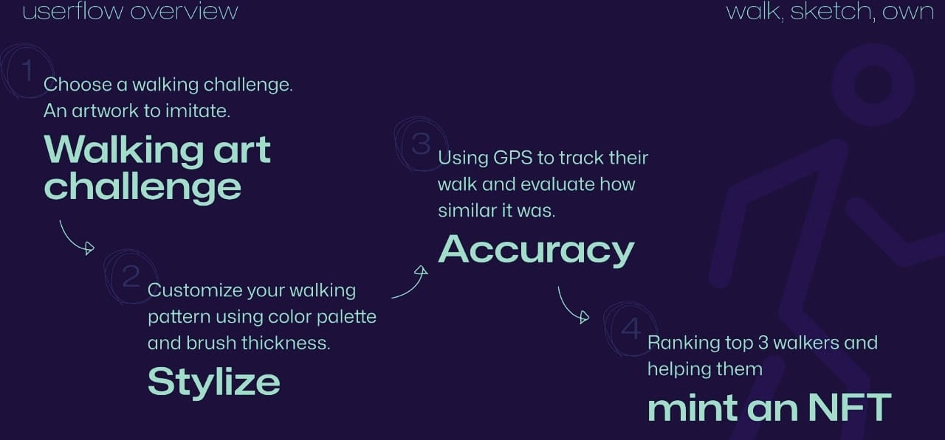

Slide 11
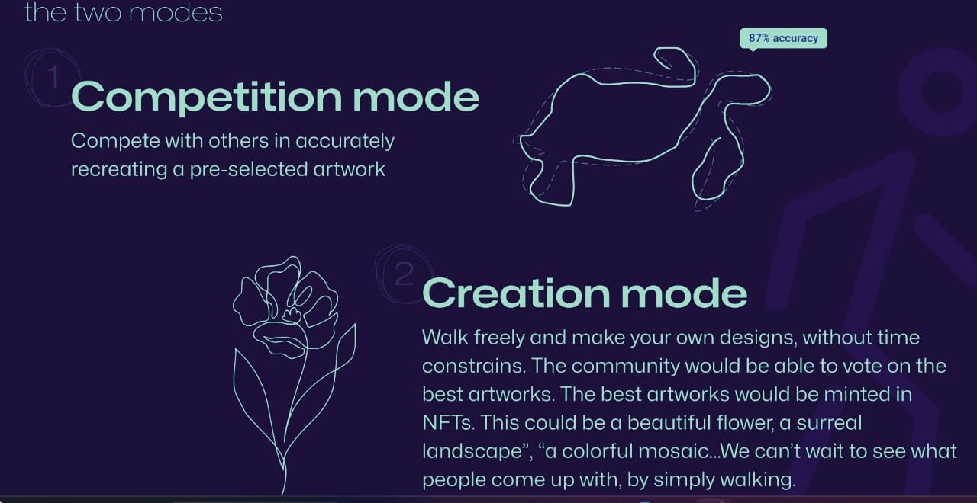

Slide 12


Slide 13
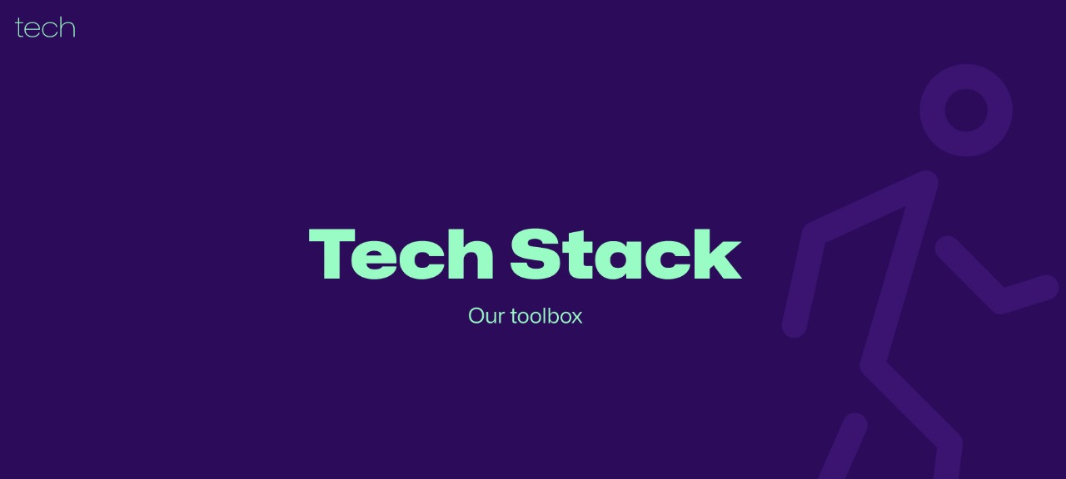

Slide 14
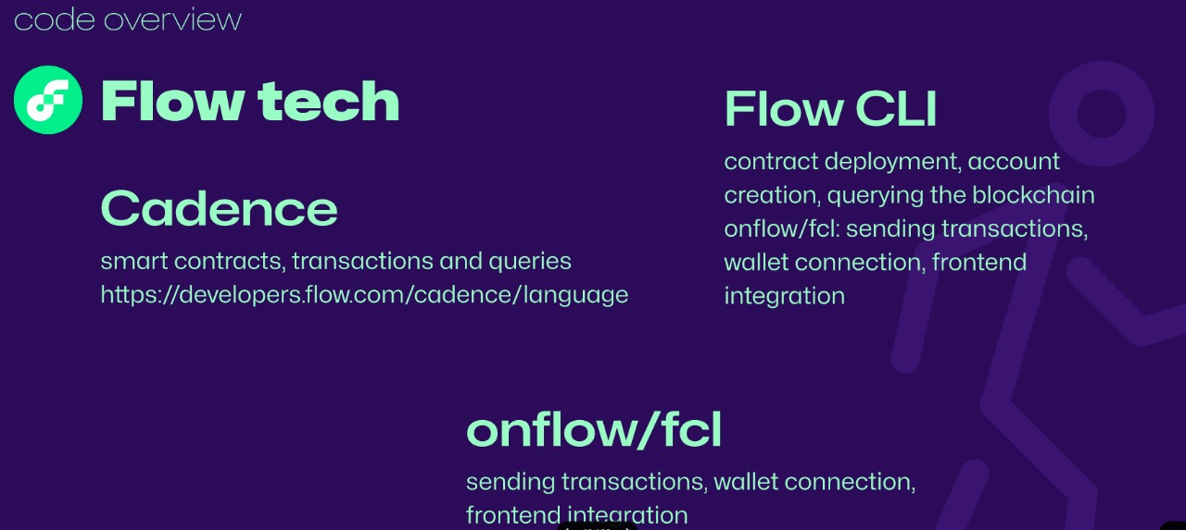

Slide 15
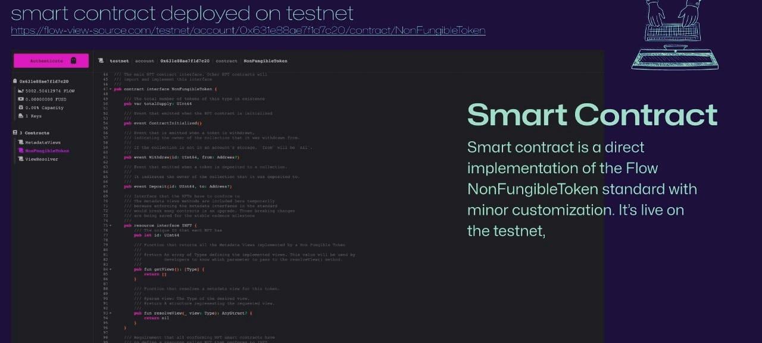

Slide 16
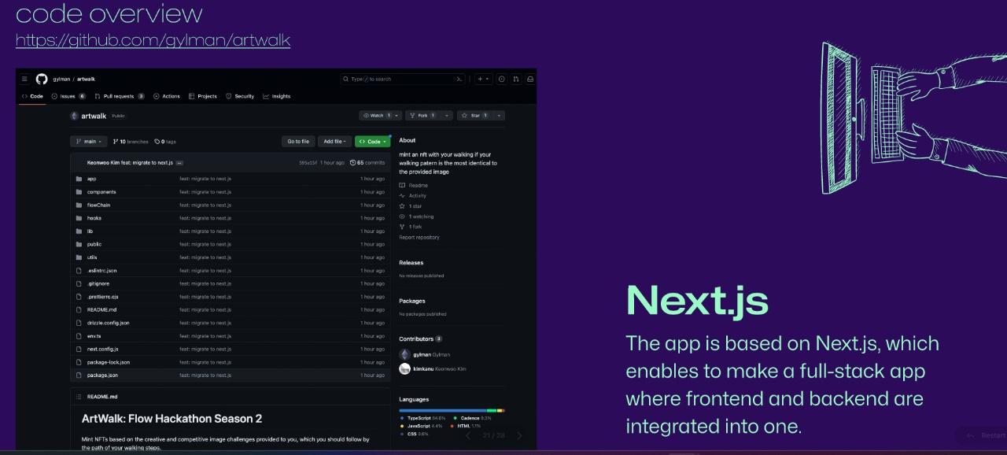
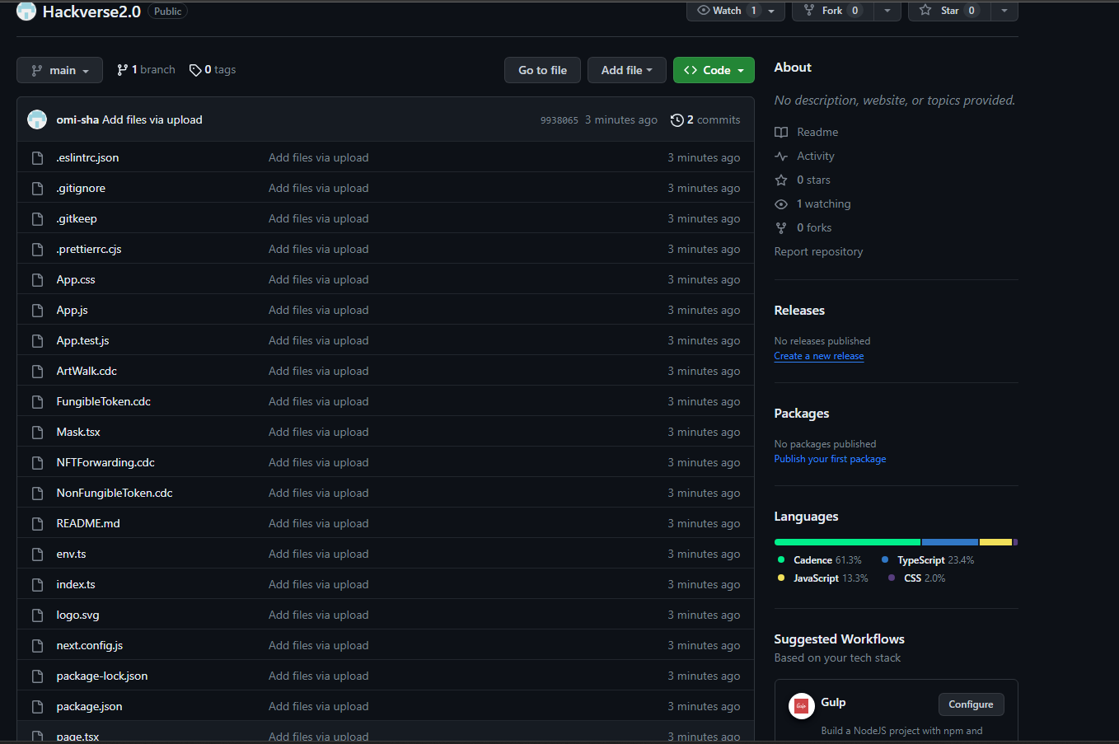
https://github.com/omi-sha/Hackverse2.0

Slide 17
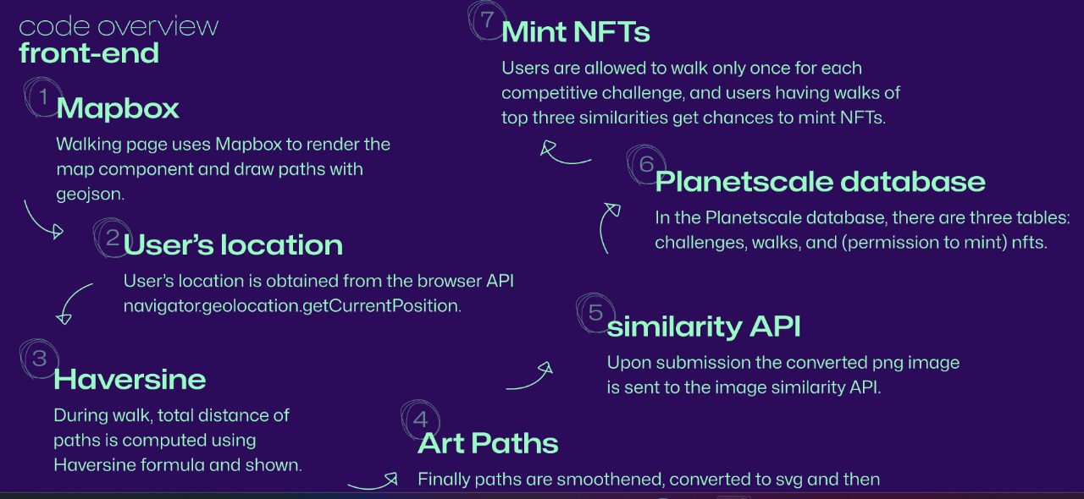

Slide 18
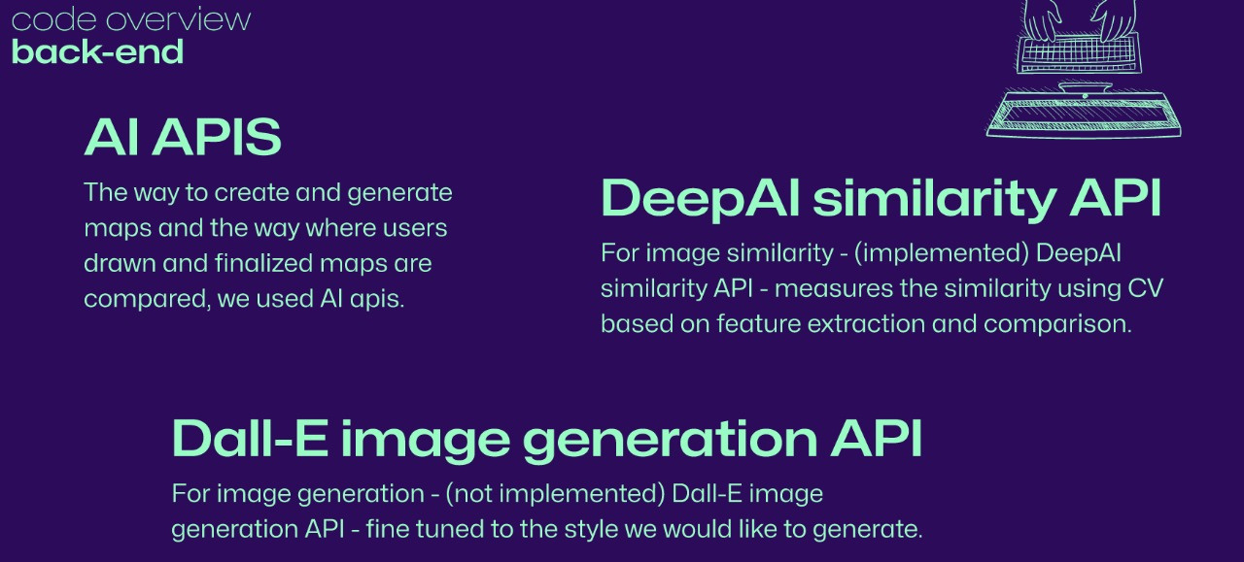

Slide 19

The Role of Wanchain
Wanchain is one such platform created with an aim to connect isolated public and private blockchains allowing for cross-chain transactions and enabling a clear flow of digital assets and data.The cross-chain message passing SDK provided by Wanchain allows developers to communicate and transfer data between these chains.
We chose Wanchain because it offers advanced cross-chain capabilities, ensuring smooth interactions between multiple blockchains. Its security, scalability, and developer-friendly tools make it the ideal choice for my project, which aims to facilitate cross-chain transactions and data recording across different blockchain networks.
We are using Wanchain's cross-chain message passing SDK to seamlessly connect our decentralized application with the Wanchain L1 blockchain and other EVM-compatible blockchains, enabling secure and efficient data transfer and transactions across multiple networks.

Slide 20
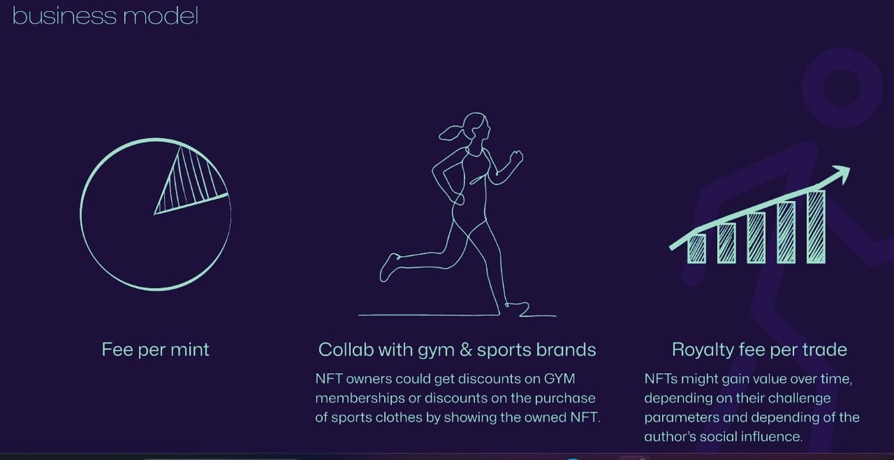

Slide 21
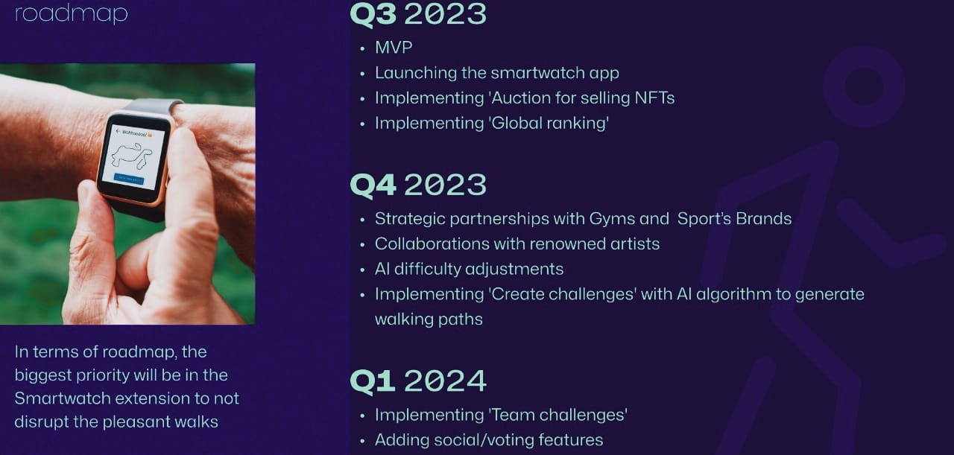

Slide 22
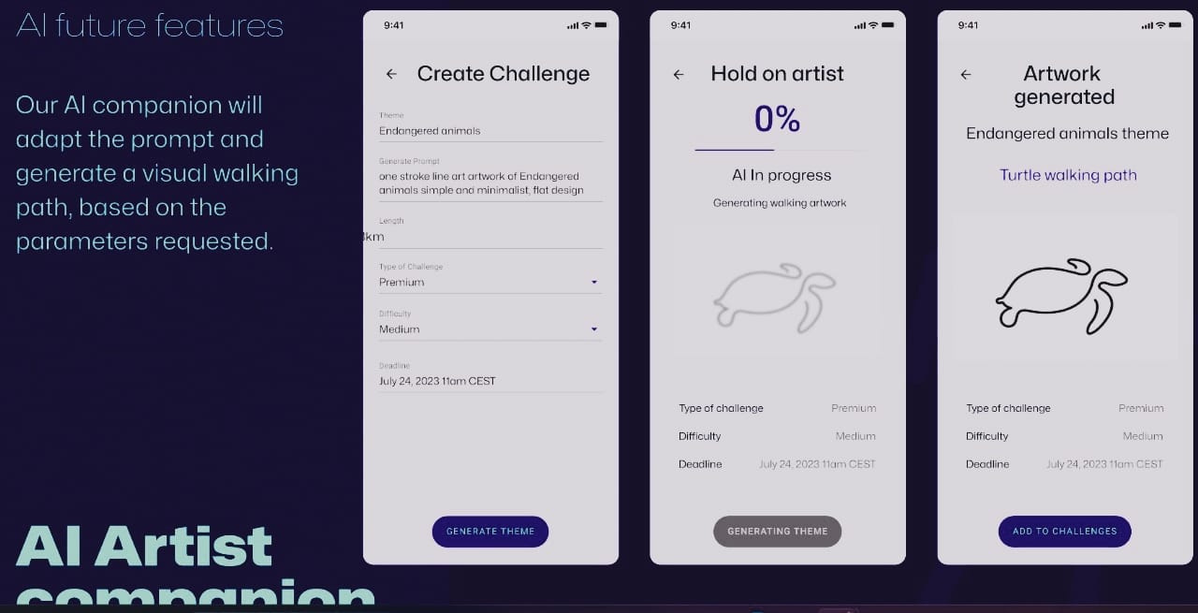

Slide 23
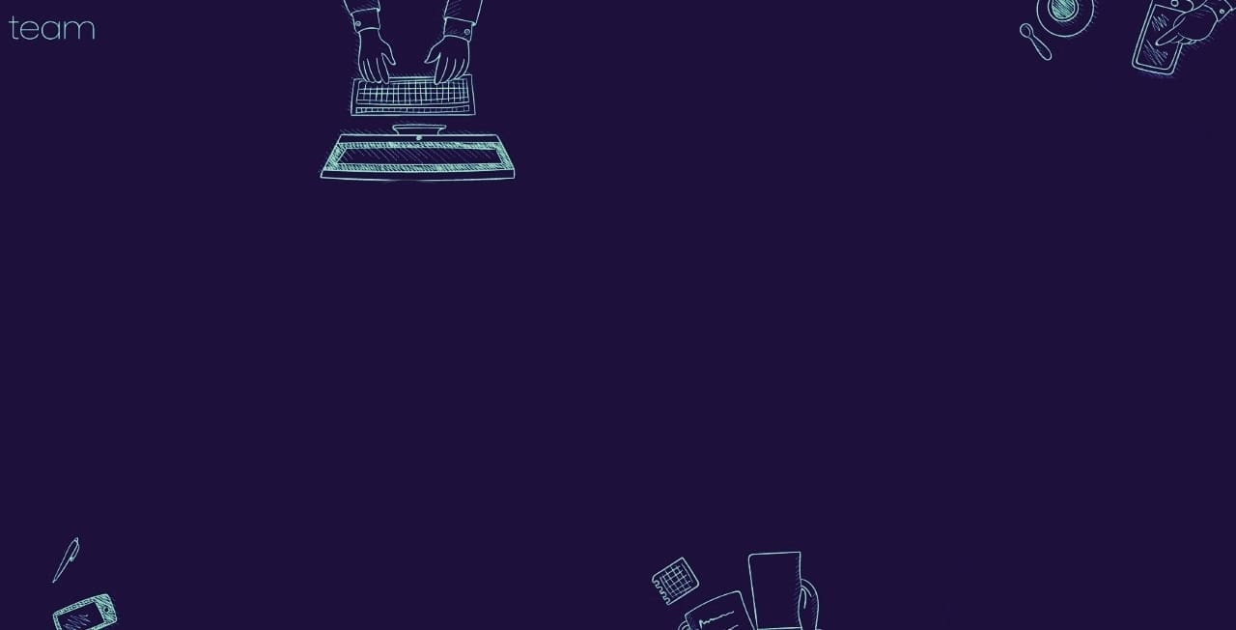
-Utkarsh Singh
-K.Sai Hemanth
-Omisha Singal
-Santhana Lakshmi
By

Slide 24
